Slide 1



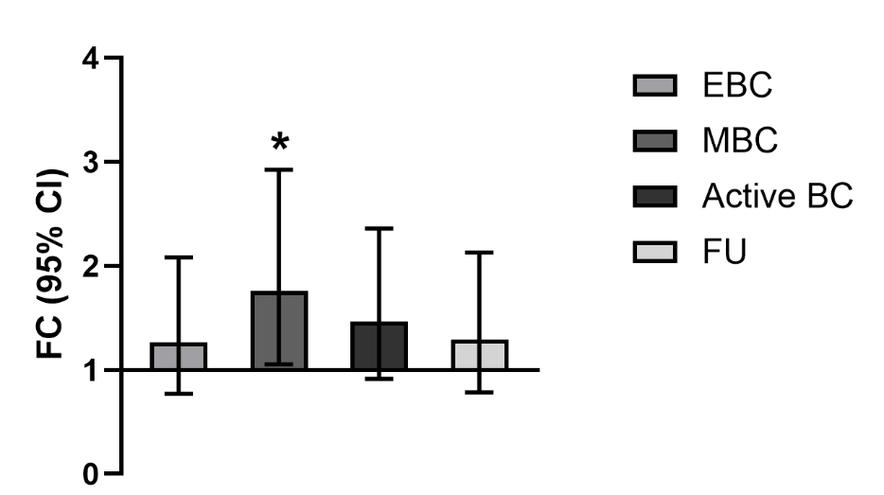
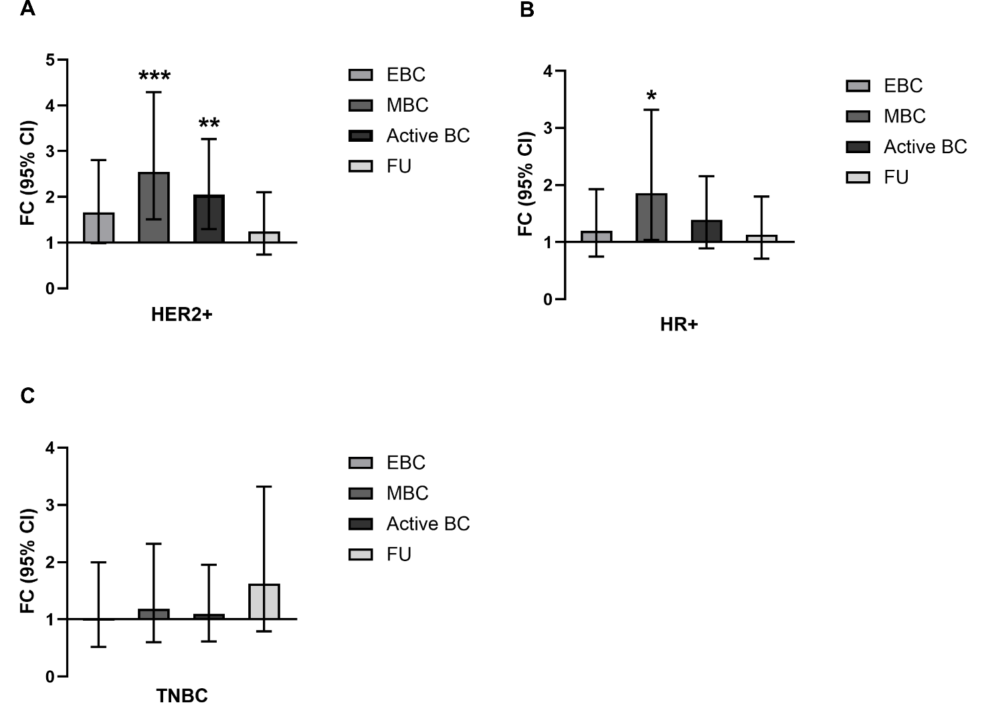
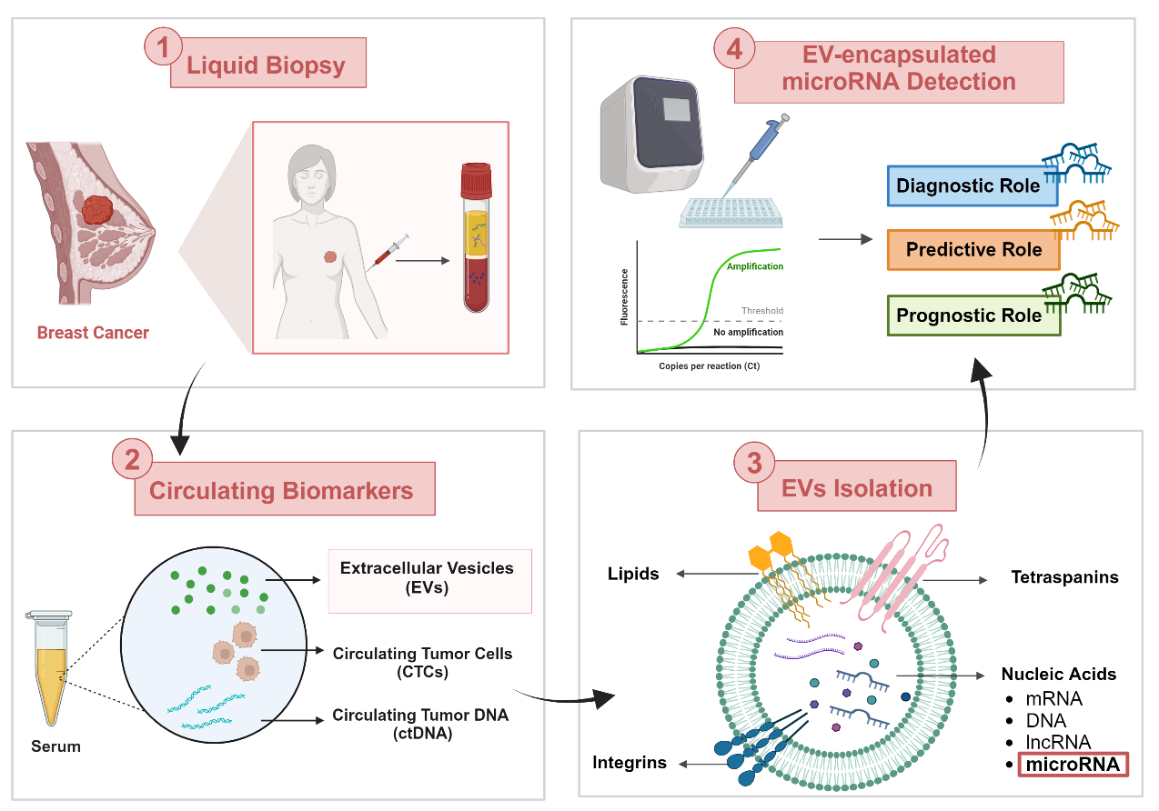
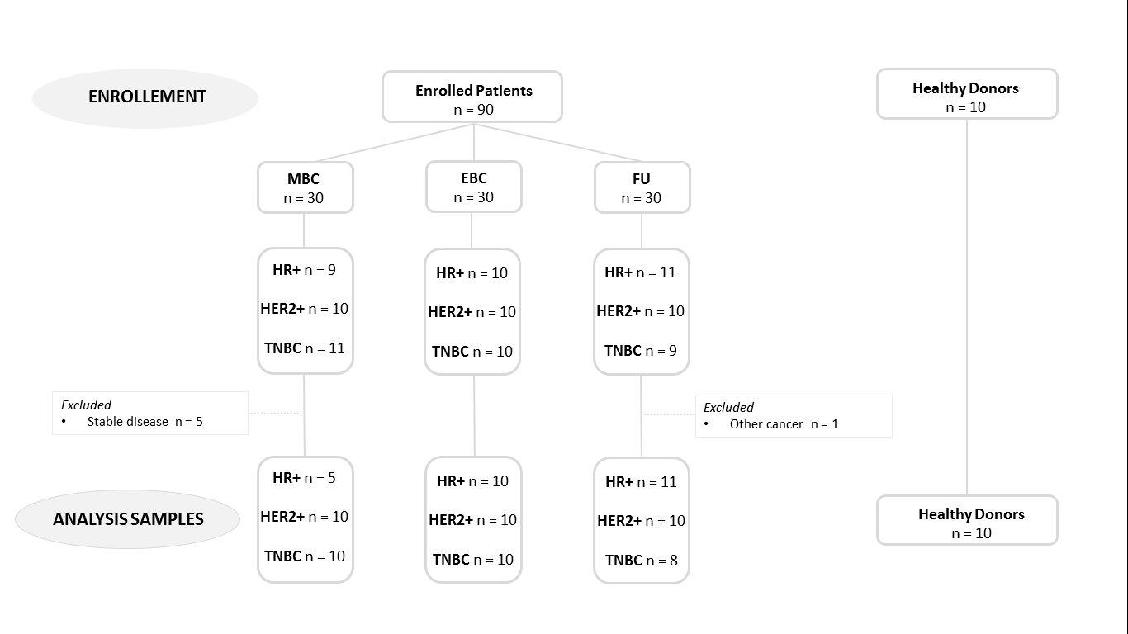
EV derived miR-21 as a promising biomarker for early diagnosis and tumor activity in discrete BC subtypes: the ExoBreast Project
417P
C. Omarini, V. Catani, A. Toss, I. Mastrolia, F. Banchelli, O. Ponzoni, M. Brucale, F. Valle, M. C. Baschieri, R. D’Amico, V. Masciale, F. Piacentini & M. Dominici
Modena Cancer Center, Department of Oncology and Hematology, Division of Oncology, University Hospital of Modena, Italy
Contact: omarini.claudia@aou.mo.it; No conflicts of interest ti declare; Funded by MIUR Dipartimenti Eccellenti 2022
BACKGROUND
Emerging evidence highlights the key role of miR-21 in cells communication and tumorigenesis. Limited knowledge exists on the expression and clinical meaning of miR-21 in extracellular vesicles (EVs) of breast cancer (BC) patients. The aim of this study has been to assess EV-derived miR-21 expression in different BC subsets.
METHODS
RESULTS
EVs isolated from serum samples were analysed by nanoparticle tracking analyzer, scanning electron microscopy and atomic force microscopy. MiR-21 expression was evaluated by Real Time PCR and compared between groups by calculating the ΔΔCt statistic and the fold change, considering miR-16 as the housekeeping gene (Fig 1).
A total of 100 women were enrolled: 30 with early BC (EBC), 30 with metastatic BC on treatment progression (MBC), 30 cancer survivors on follow up (FU) and 10 healthy donors (HD) as controls (Fig 2).
No differences in EVs size and concentration among the four groups.
Higher expression of miR-21 has been found in metastatic versus healthy controls (FC=1.758, 95% CI 2.926 to 1.057; p= 0.02) (Fig 3).
Figure 3. miR-21 expression: real Time PCR analysis of all BC patients
Considering BC subtype:
Higher miR-21 has been seen in HER2+ (FC= 2.545, 95% CI 4.289 to 1.510; p=0.0005) and HR+ MBC (FC= 1.857, 95% CI 3.320 to 1.039; p=0.03) (Fig 4).
In HER2+, miR-21 was significantly higher in those with active BC (early and metastatic) (FC= 2.058, 95% CI 3.265 to 1.298; p=0.002) compared to control group (Fig 4A).
Figure 4. Real Time PCR analysis of BC subgroup. The expression of miR-21 was evaluated in (A) HER2+, (B) HR+ and (C) TNBC patients compared to HDs. A statistically significant difference is detected in MBC (p=0.0005) and active BC (p=0.002) in HER2+ subgroup and in MBC (p=0.03) for HR+ subgroup
CONCLUSIONS
Fig 1. A image of the study design
Figure 2. Flow chart of patients’ enrollment
miR-21 may be a promising biomarker for early diagnosis and tumor activity, mainly in HER2+ BC

